Slide 1
Junghuei Chen, 105 Drake, 831-1035, Junghuei@udel.edu.
Office Hours: Wednesdays, 9:30-11:30 AM
Down Load Power Points:
http://www.udel.edu/chem/course/chem642.html
(Chapters 2, 6-18, 21-22)
Grading: First exam (30%), Second Exam (30%), Final examination (40%).
Date to Remember:
First Exam: March 10 (Saturday) 10am.
March 24, April 1 (Spring recess; no class)
Second Exam: April 14 (Saturday) 10 am.
Last day of class: May 15.
Final exams week: May 17-24.

Slide 2
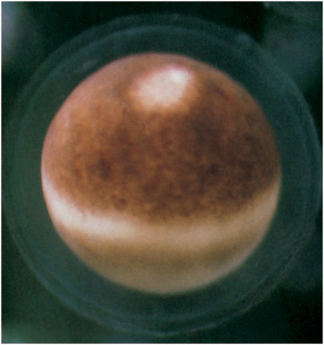
All cells store their genetic information in DNA
An egg cell.
The DNA of this single cell contains the genetic information needed to specify construction of an entire multi-cellular animal.

Slide 3
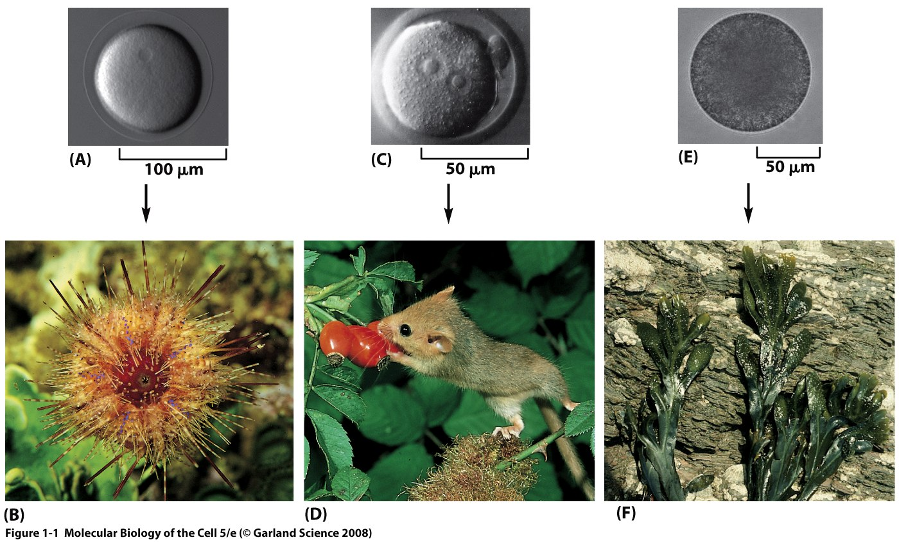
Figure 1–1 The hereditary information in the egg cell determines the nature of the whole multicellular organism. (A and B) A sea urchin egg gives rise to a sea urchin. (C and D) A mouse egg gives rise to a mouse. (E and F) An egg of the seaweed Fucus gives rise to a Fucus seaweed.

Slide 4
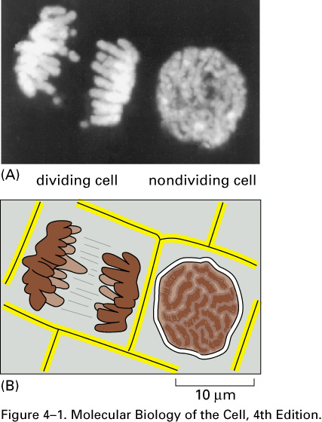
Hereditary information is carried on Chromosomes that consist of both DNA and proteins
Chromosomes in cells.
(A) Two adjacent plant cells photographed through a light microscope. The DNA has been stained with a fluorescent dye (DAPI) that binds to it. The DNA is present in chromosomes, which become visible as distinct structures in the light microscope only when they become compact structures in preparation for cell division, as shown on the left. The cell on the right, which is not dividing, contains identical chromosomes, but they cannot be clearly distinguished in the light microscope at this phase in the cell’s life cycle, because they are in a more extended conformation. (B) Schematic diagram of the outlines of the two cells along with their chromosomes.

Slide 5
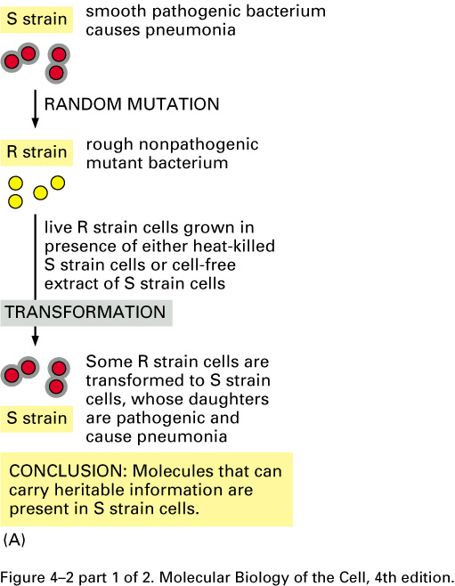
Nucleic Acids Convey Genetic Information
Experimental demonstration that DNA is the genetic material.
(Avery, 1944)
These experiments, carried out in the 1940s, showed that adding purified DNA to a bacterium changed its properties and that this change was faithfully passed on to subsequent generations. Two closely related strains of the bacterium Streptococcus pneumoniae differ from each other in both their appearance under the microscope and their pathogenicity. One strain appears smooth (S) and causes death when injected into mice, and the other appears rough (R) and is non-lethal. (A) This experiment shows that a substance present in the S strain can change (or transform) the R strain into the S strain and that this change is inherited by subsequent generations of bacteria.

Slide 6
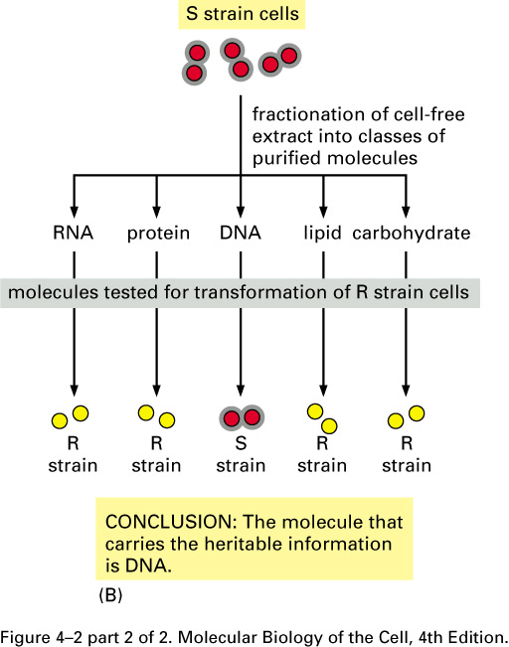
(B) This experiment, in which the R strain has been incubated with various classes of biological molecules obtained from the S strain, identifies the substance as DNA.

Slide 7
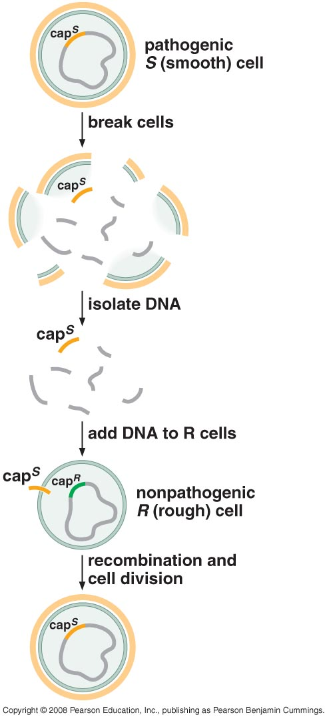
Isolation of a chemically pure transforming agent

Slide 8
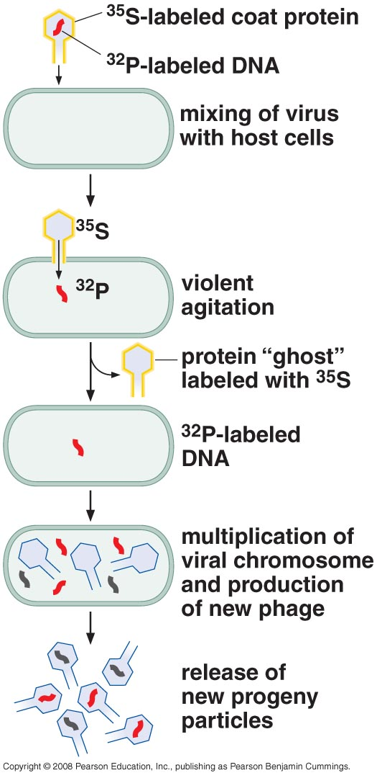
Viral Genes are also nucleic acids
(Hershey & Chase. 1952)
Only the DNA component of T2 carries the genetic information

Slide 9
The DNA Double Helix
Stabilized by hydrogen bonds!
"Base pairs" arise from hydrogen bonds
Erwin Chargaff had the pairing data, but didn't understand its implications
Rosalind Franklin's X-ray fiber diffraction data was crucial
Francis Crick knew it was a helix
James Watson figured out the H-bonds

Slide 10
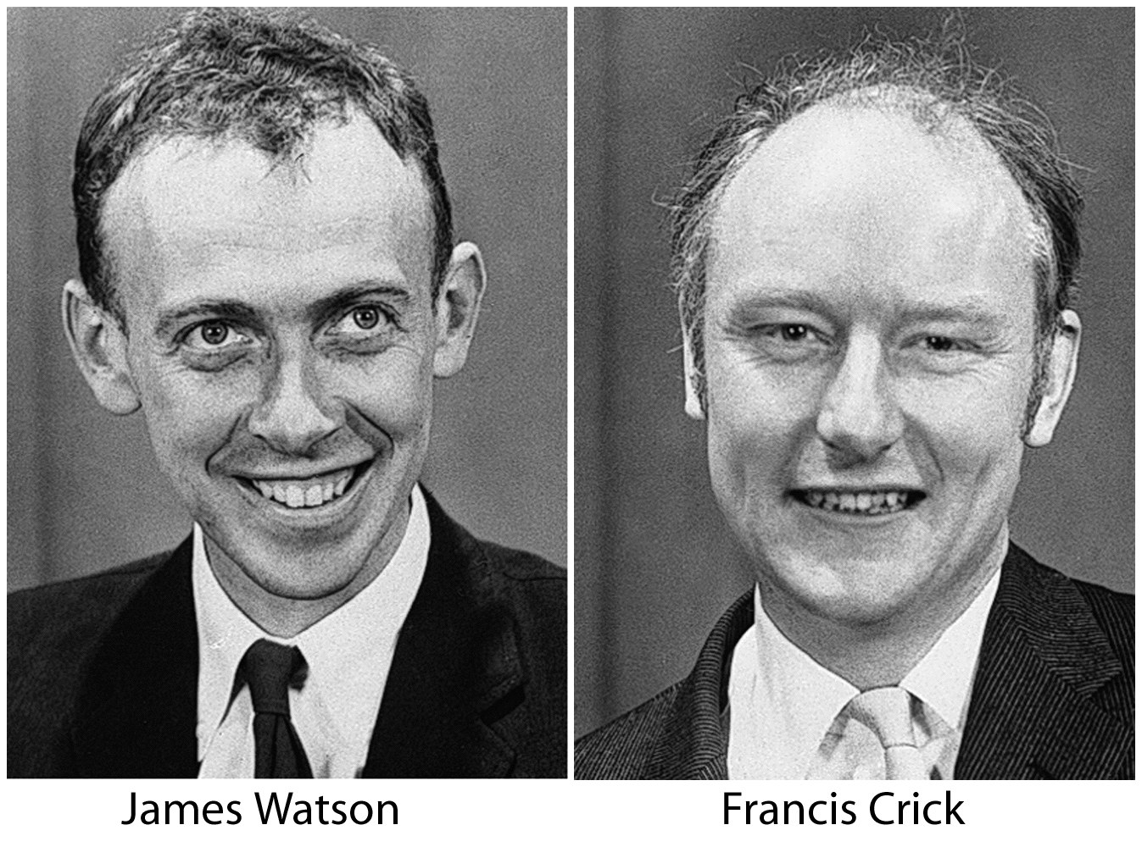

Slide 11
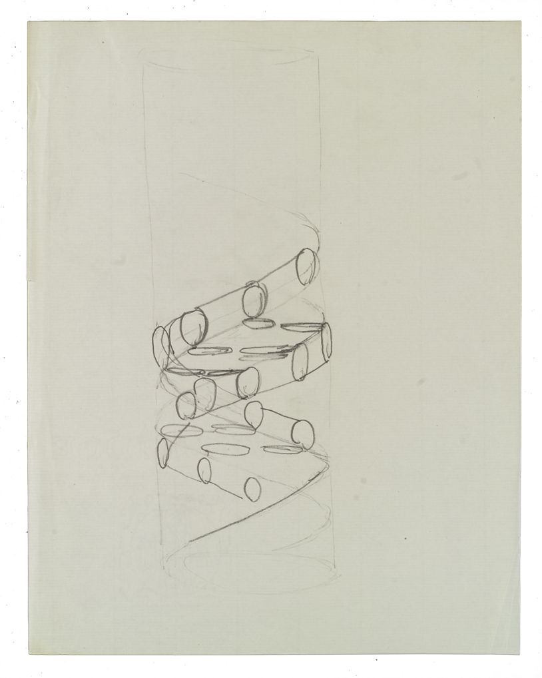
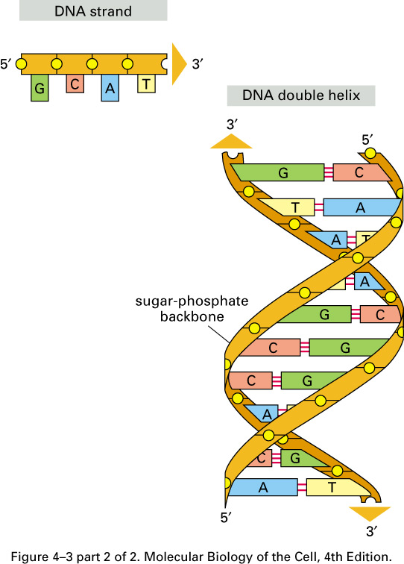
www.profiles.nlm.nih.gov

Slide 12
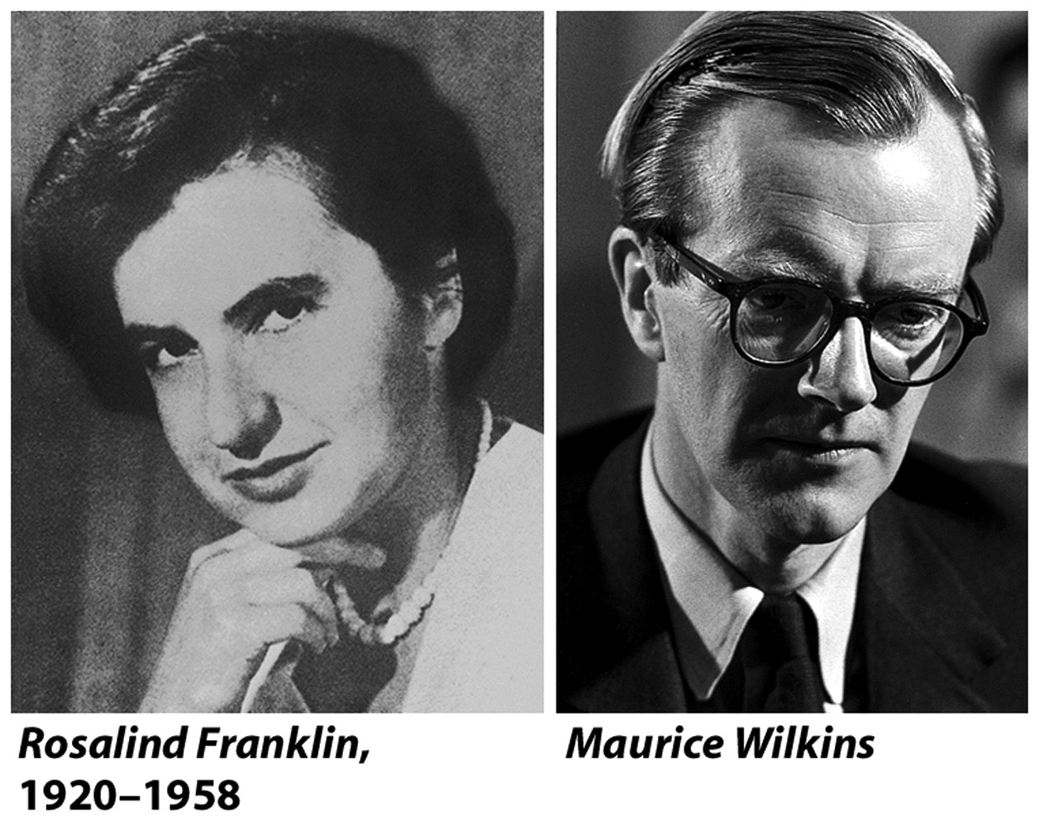

Slide 13
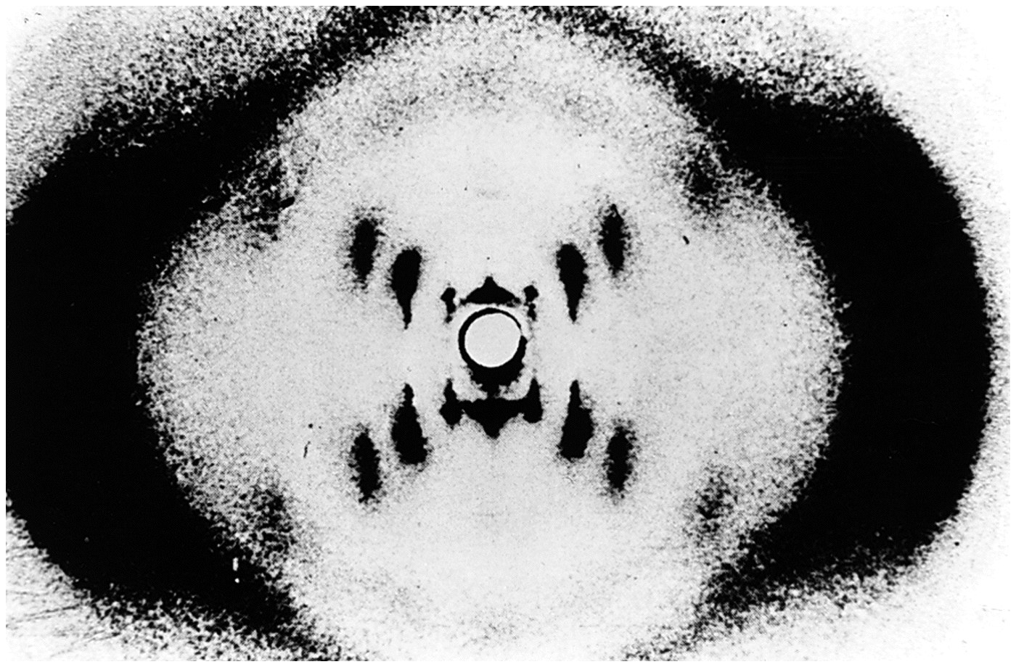

Slide 15
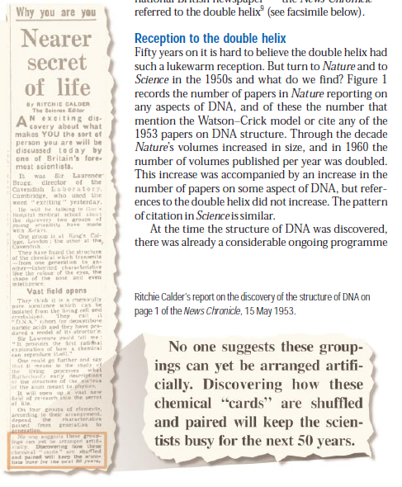

Slide 16
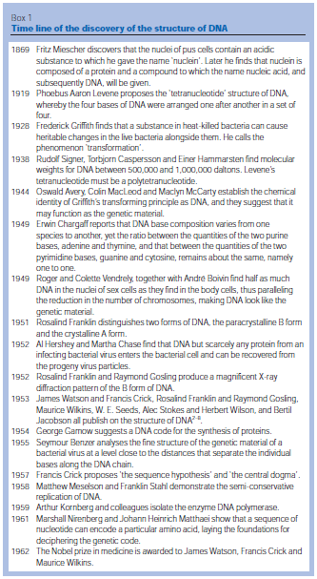

Slide 17
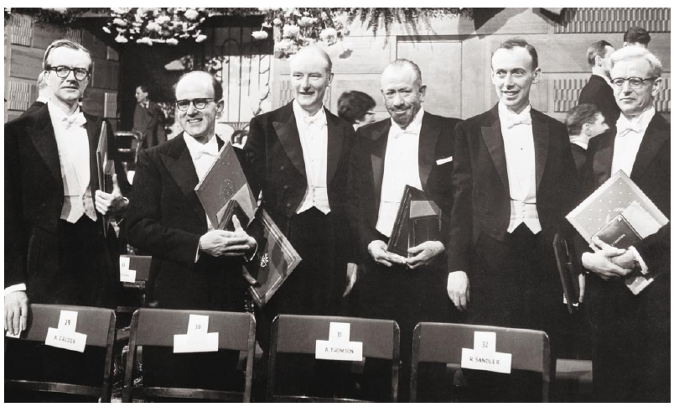
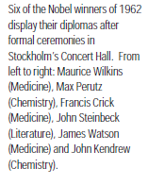

Slide 18
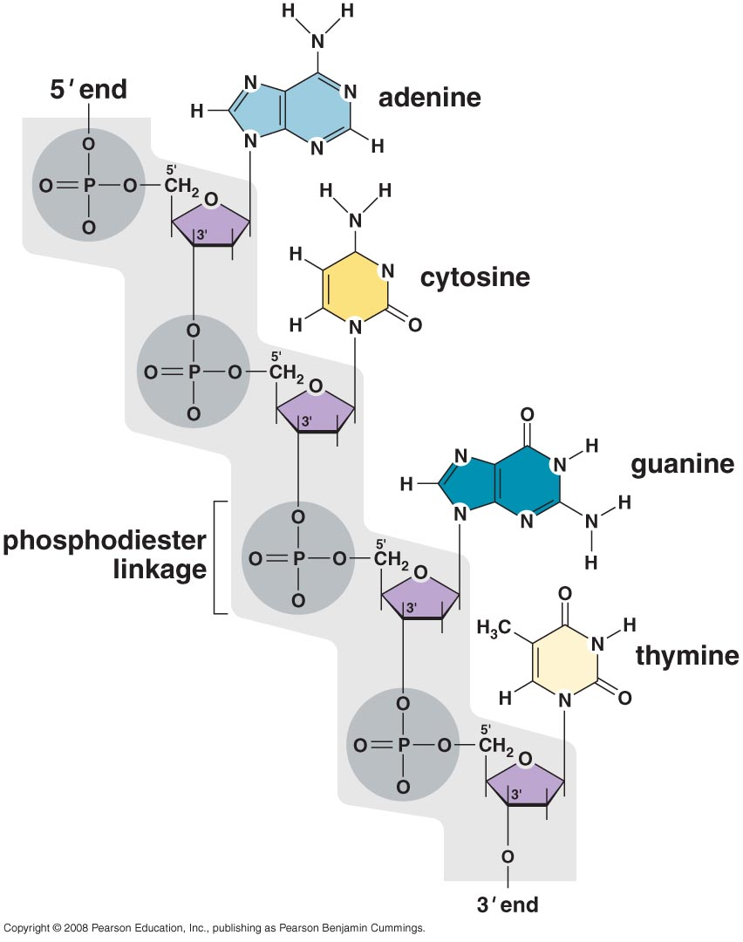
A portion of a DNA polynucleotide chain

Slide 19
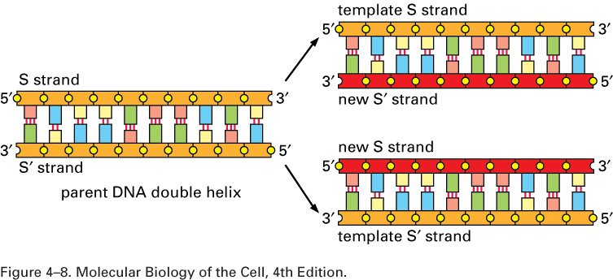
DNA as a template for its own duplication.
As the nucleotide A successfully pairs only with T, and G with C, each strand of DNA can specify the sequence of nucleotides in its complementary strand. In this way, double-helical DNA can be copied precisely.

Slide 20
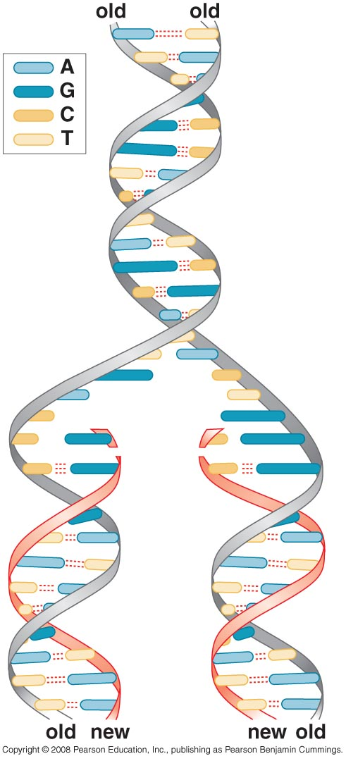
Finding the polymerases that make DNA
The replication of DNA

Slide 21
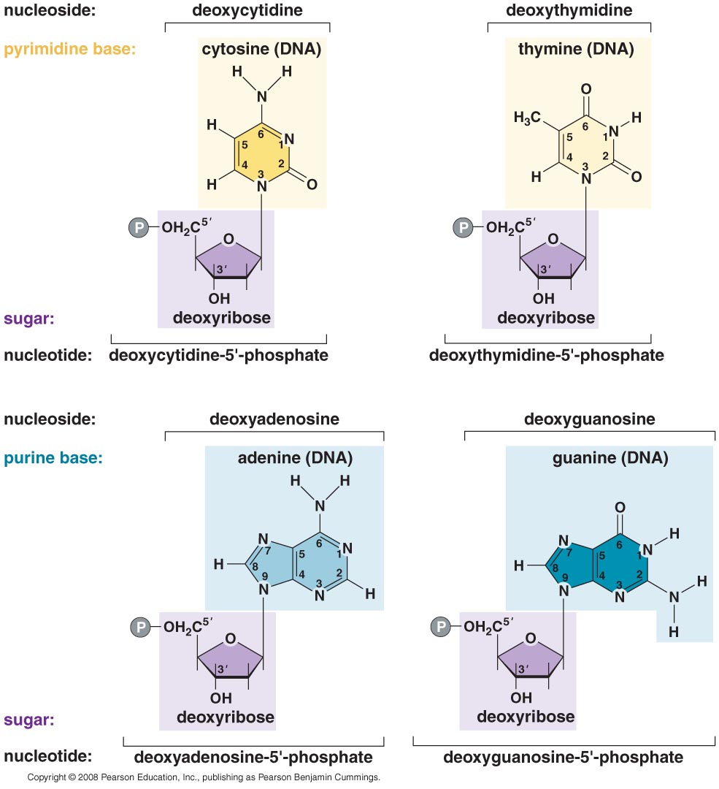
The nucleotides of DNA

Slide 22
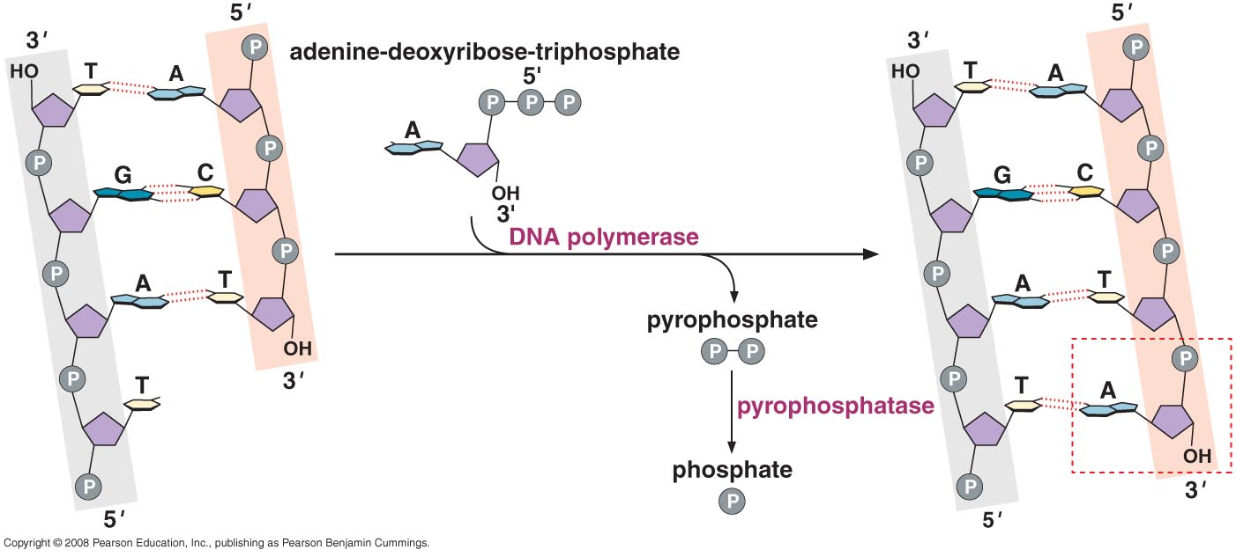
Enzymatic synthesis of a DNA chain catalyzed by DNA polymerase I

Slide 23
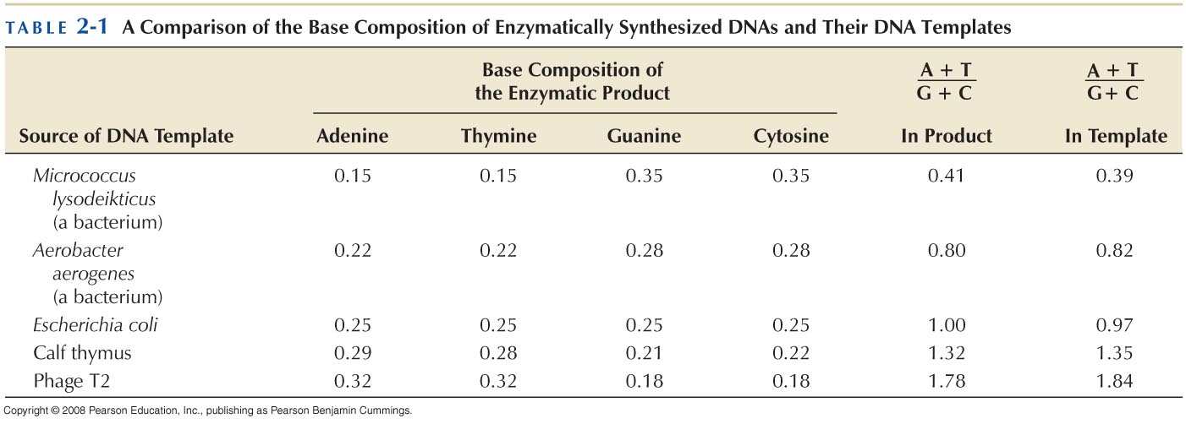
DNA synthesis depends on template DNA

Slide 24
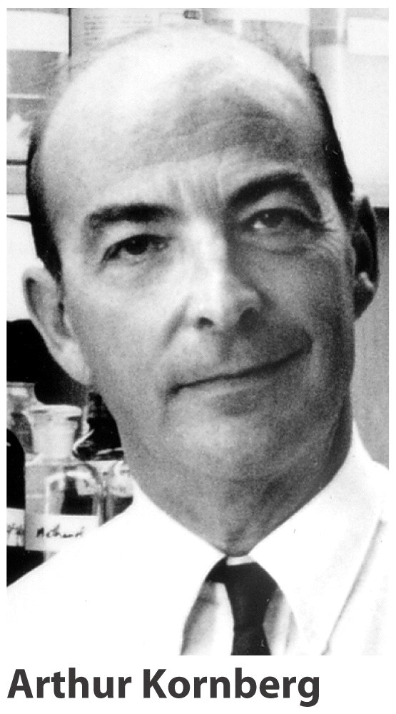
In 1959 isolated DNA polymerase

Slide 25
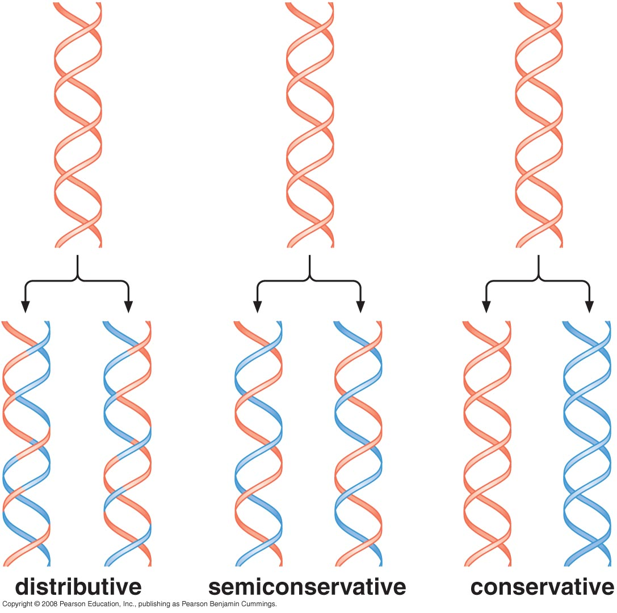

Slide 26
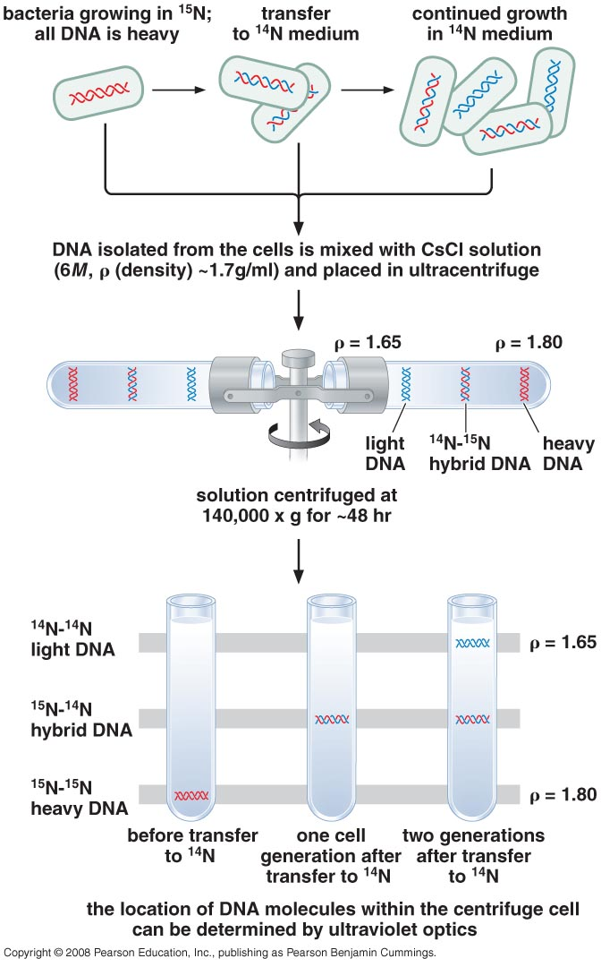
Experimental evidence favors strand separation during DNA replication
Meselson & Stahl experiment
Demonstrated that DNA replication is semi-conservative
(1958)

Slide 27
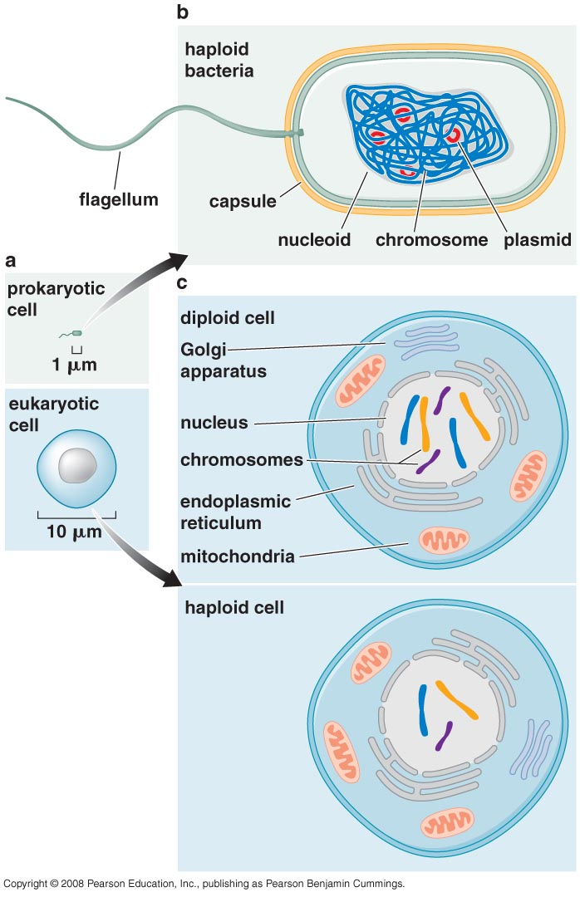
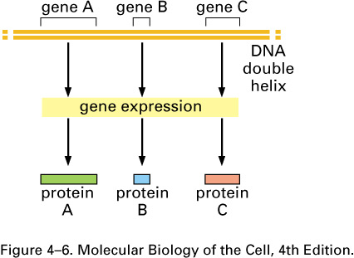
The genetic information within DNA is conveyed by its sequences; How the genetic information of DNA functions to order amino acids during protein synthesis?
DNA cannot be the template that directly orders amino acids during protein synthesis (protein synthesis in all eukaryotic cells occurs in cytoplasm)

Slide 28
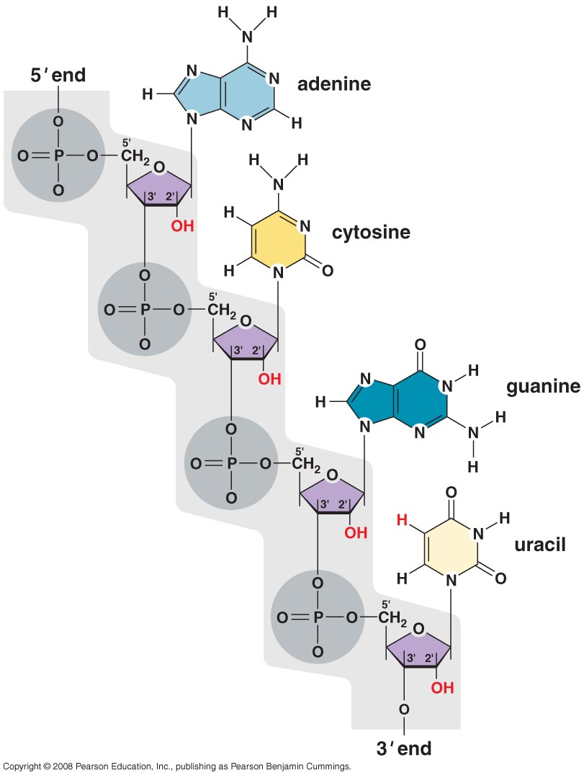
RNA is chemically very similar to DNA and reside largely in the cytoplasm

Slide 29
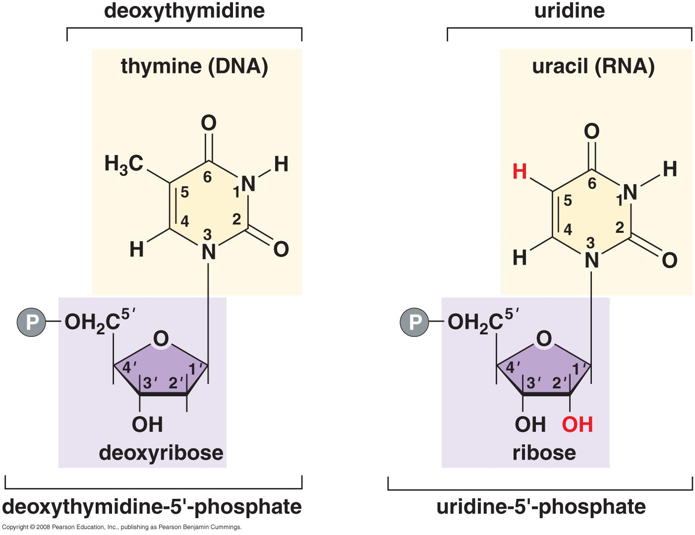
Distinctions between the nucleotides of RNA and DNA
The chemical structure of RNA.
(A) RNA contains the sugar ribose, which differs from deoxyribose, the sugar used in DNA, by the presence of an additional –OH group. (B) RNA contains the base uracil, which differs from thymine, the equivalent base in DNA, by the absence of a –CH3 group.

Slide 30
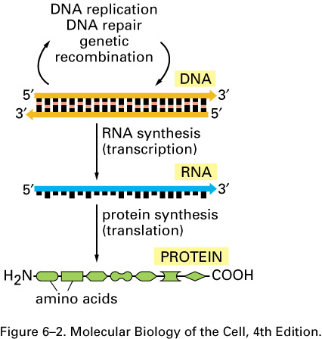
THE CENTRAL DOGMA
The pathway from DNA to protein.
The flow of genetic information from DNA to RNA (transcription) and from RNA to protein (translation) occurs in all living cells.

Slide 31
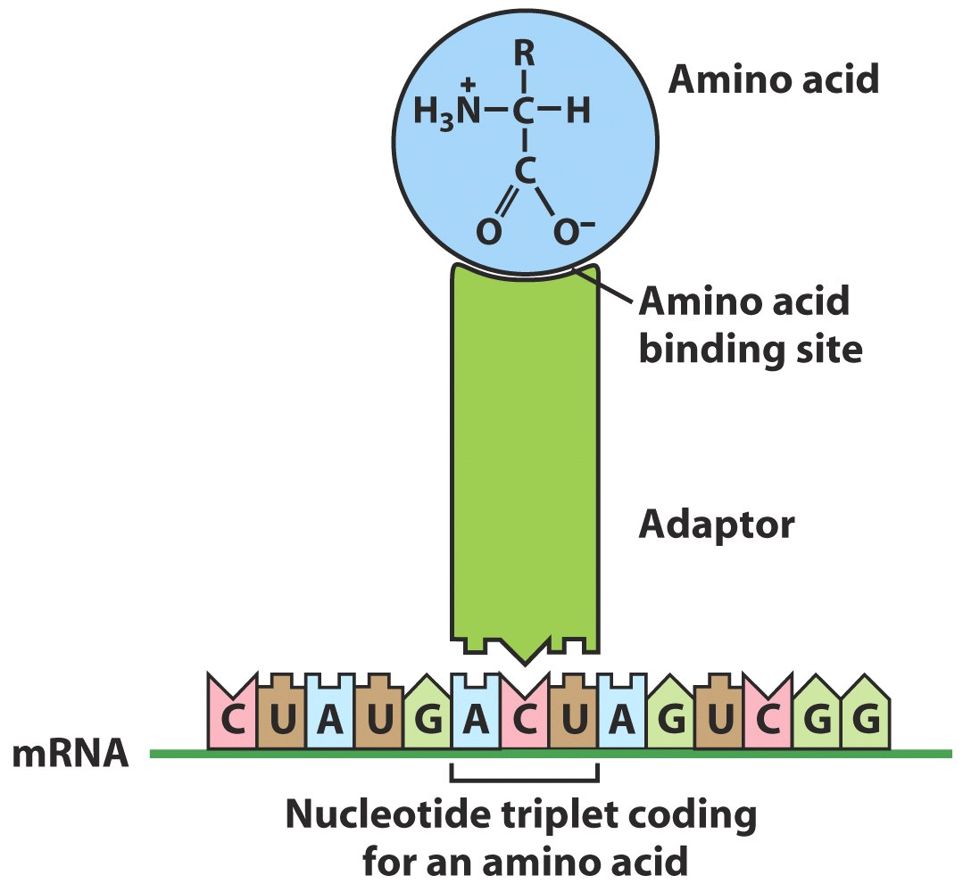
Crick’s adaptor hypothesis
tRNA molecules match amino acids to codons in mRNA

Slide 32
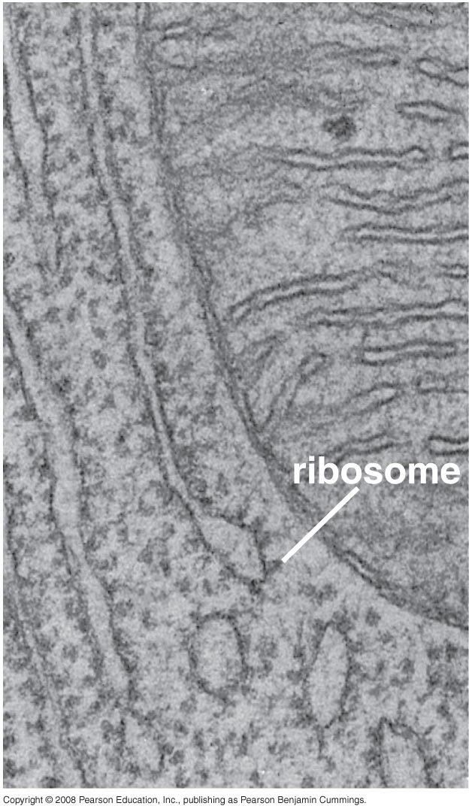
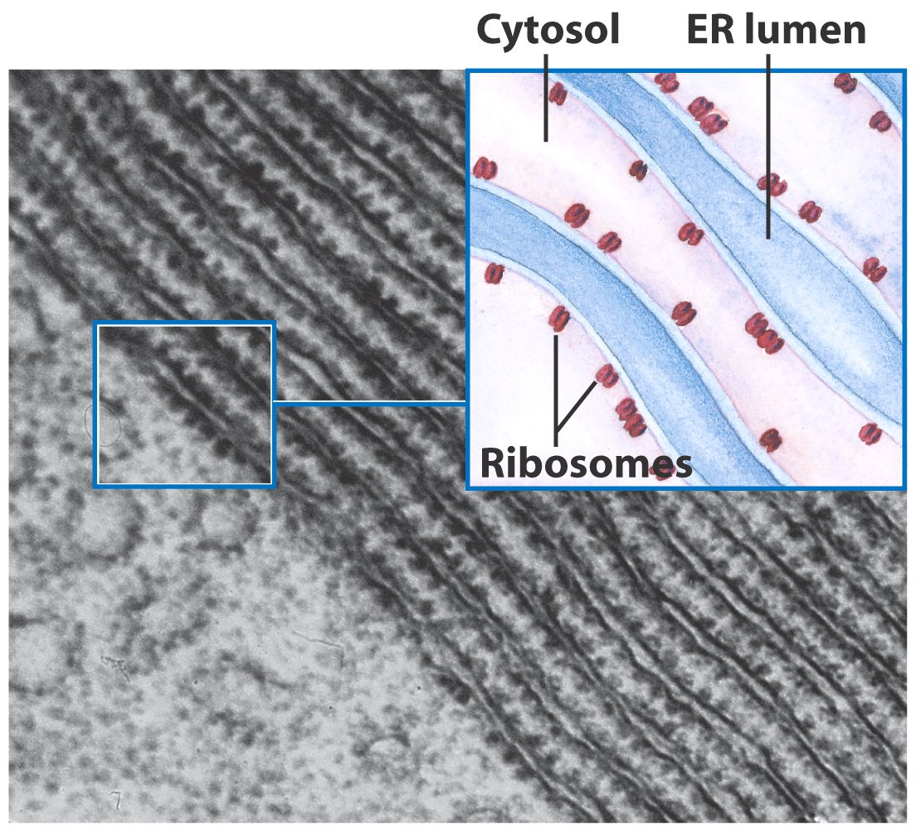
Discovery of Transfer RNA
In 1953, Zamecnik discovered that protein synthesis occurs in Ribosome

Slide 33
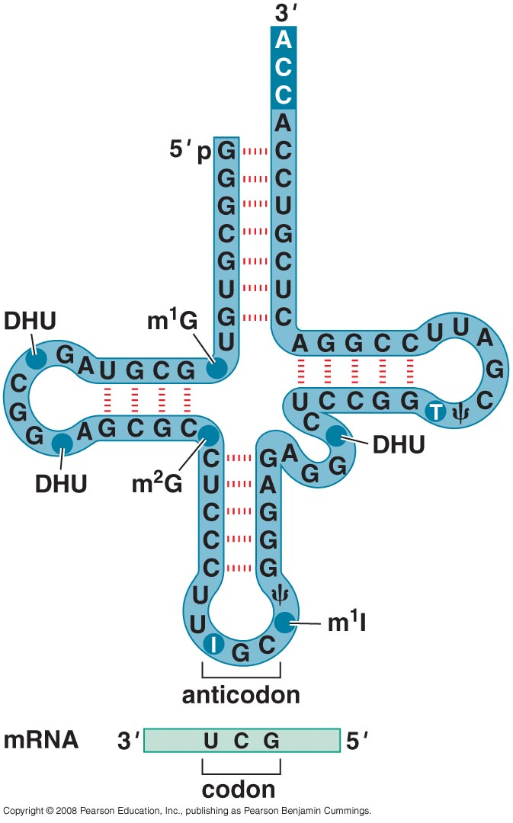
Several years later, Zamecnik also discovered that prior to their incorporation into proteins, amino acids are first attached to transfer RNA molecules (tRNA)

Slide 34
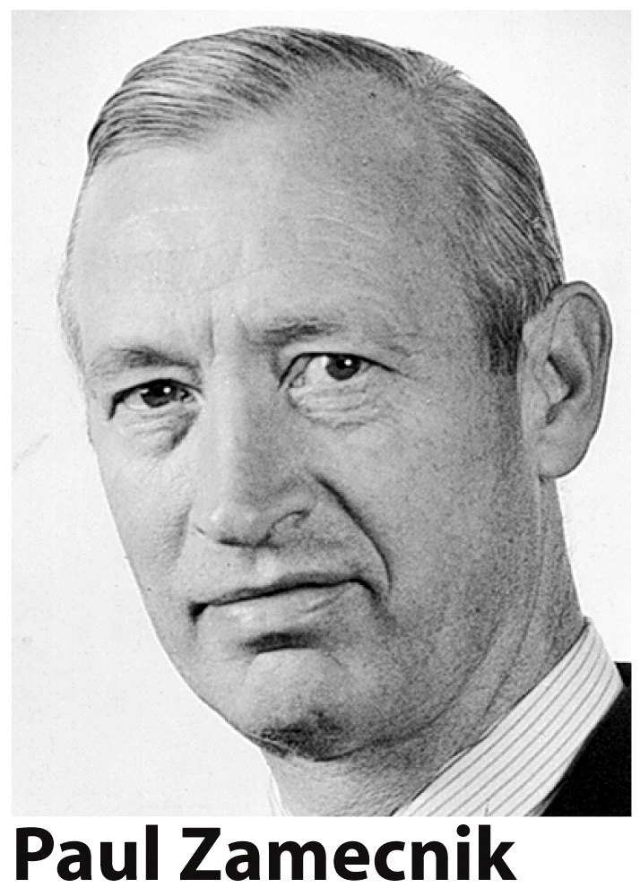

Slide 35
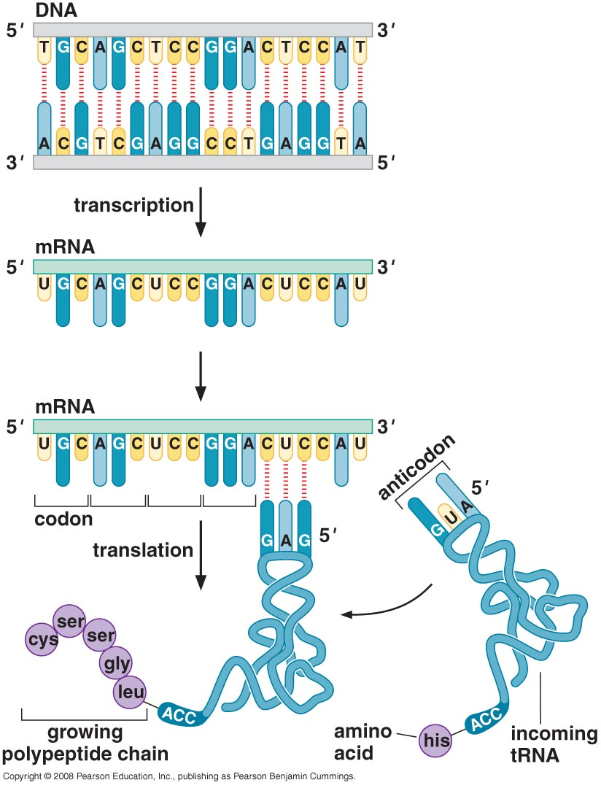
Evidences suggested that ribosomal RNA (rRNA) is NOT the template for ordering amino acids during protein synthesis
Discovery of messenger RNA
(mRNA)

Slide 36
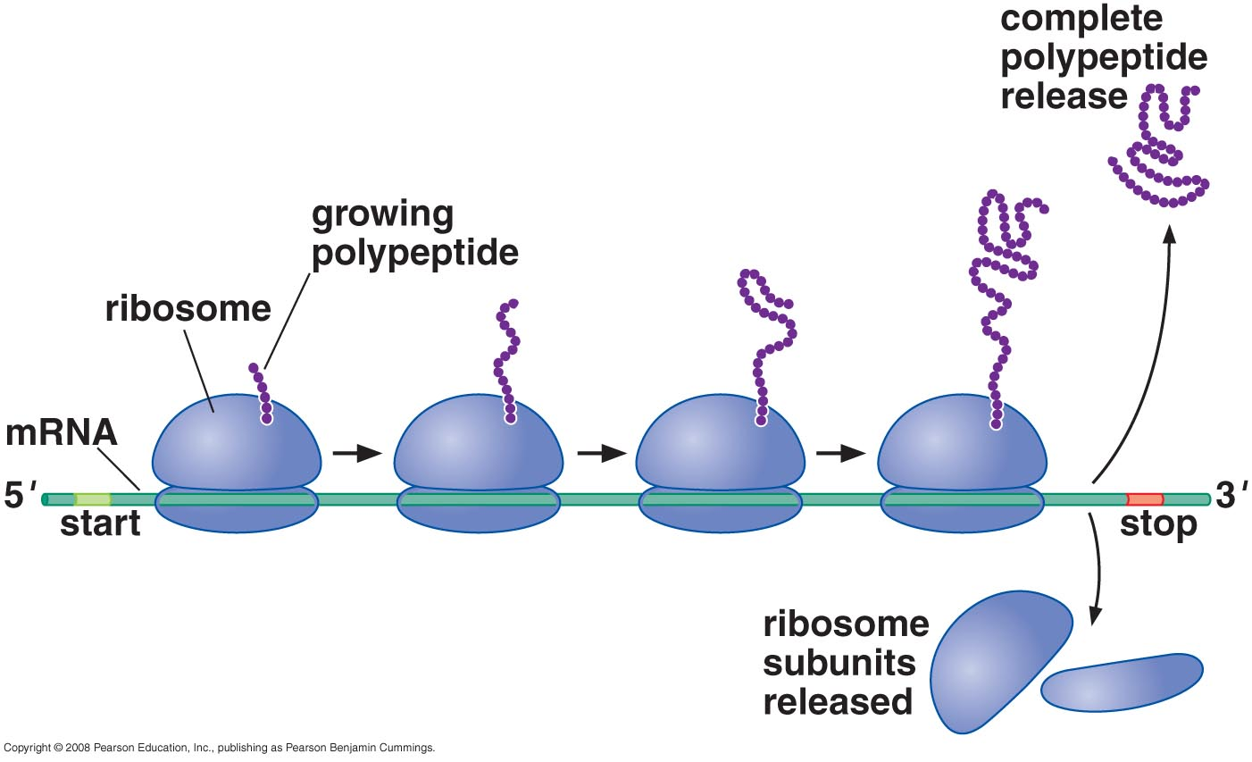
A polyribosome: Because only a small segment of mRNA is attached at a given moment to a ribosome, a single mRNA can simultaneously read be read by many ribosomes.

Slide 37
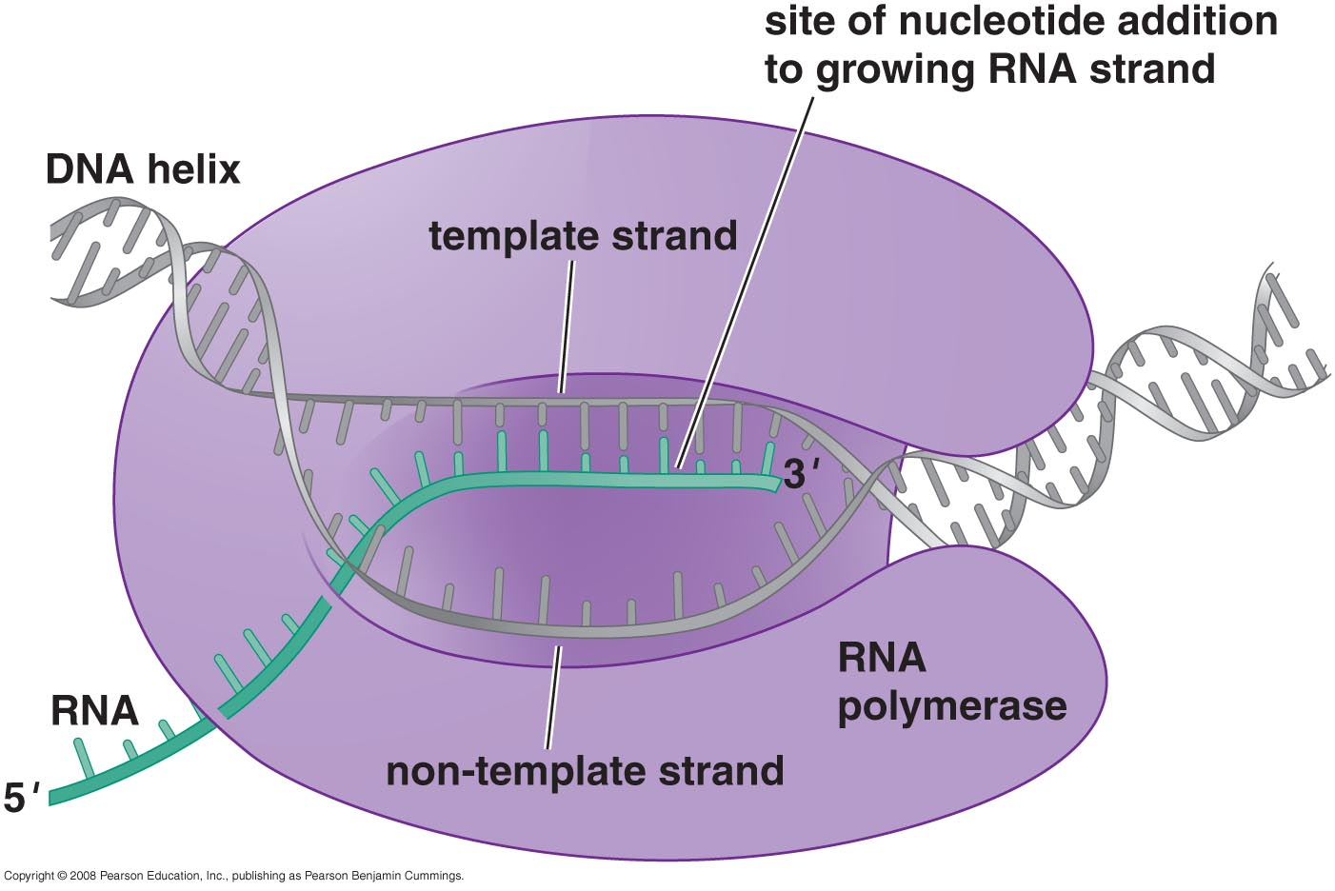
Enzymatic synthesis of RNA upon DNA templates
J. Hurwitz and S. Weiss discovered RNA polymerase that synthesize RNA using DNA templates

Slide 38
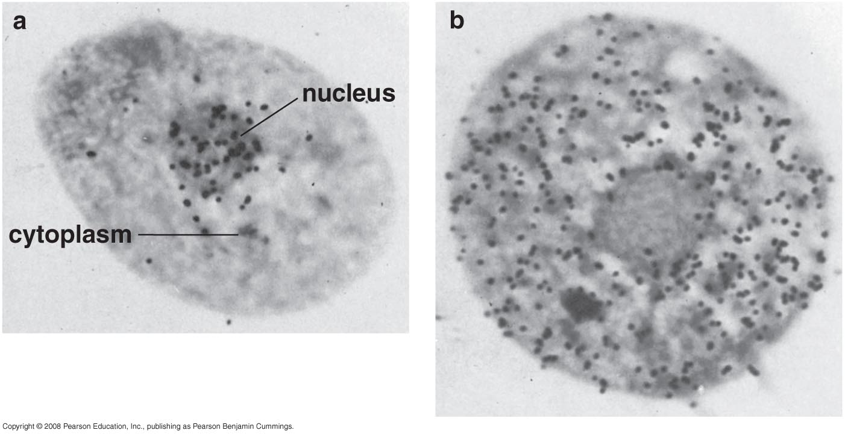
Demonstration that mRNA is synthesized in the nucleus and moves to the cytoplasm

Slide 39
Establishing the genetic code
In 1961, using genetic analysis, Crick & Brenner established that mRNA sequence is decoded in set of three nucleotides (codons). But which codons determine which amino acids?

Slide 40
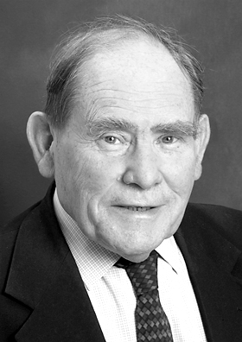
The Nobel Prize in Physiology or Medicine 2002 was awarded jointly to Sydney Brenner, H. Robert Horvitz and John E. Sulston "for their discoveries concerning 'genetic regulation of organ development and programmed cell death'".

Slide 41
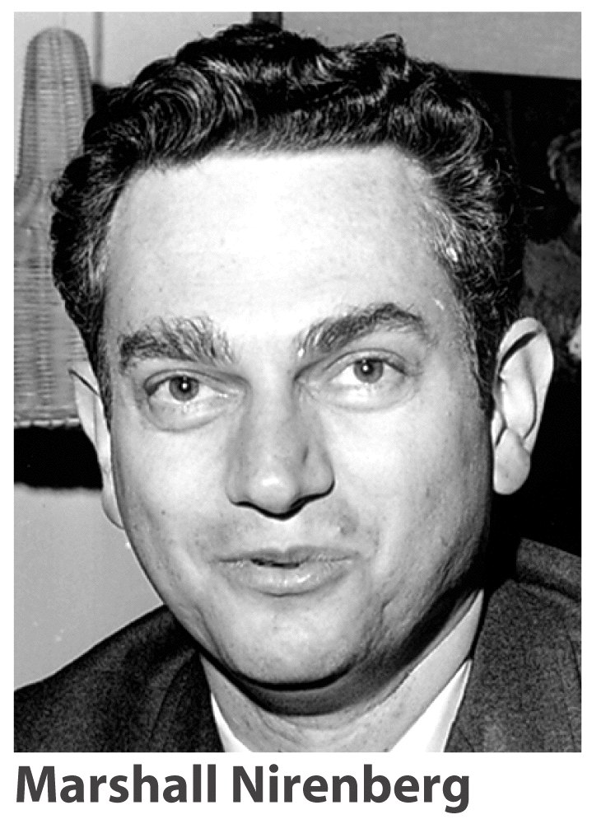
The genetic code was cracked using artificial mRNA template
But which codons determine which amino acids?

Slide 42
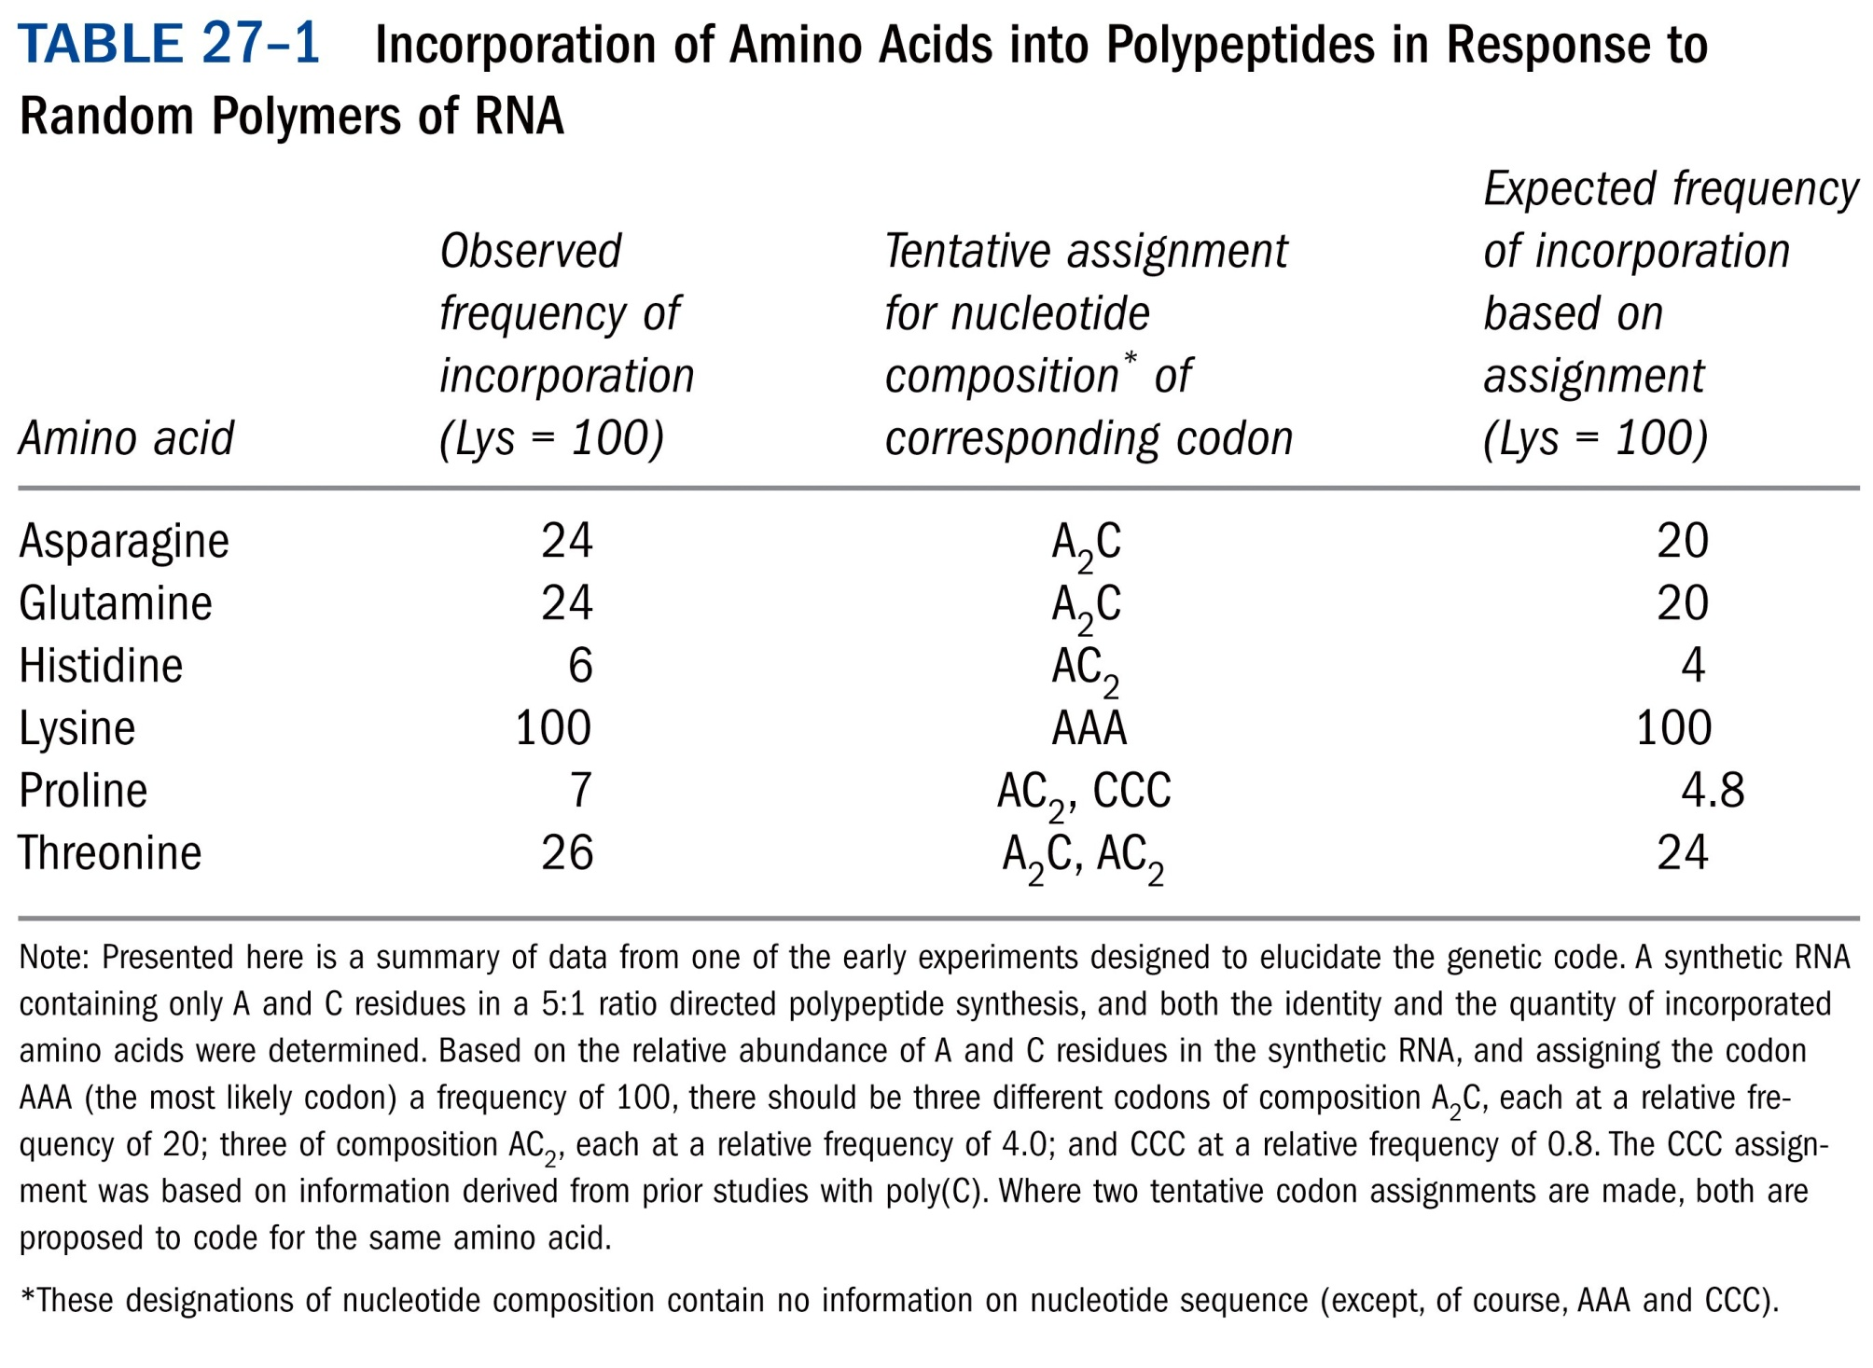

Slide 43
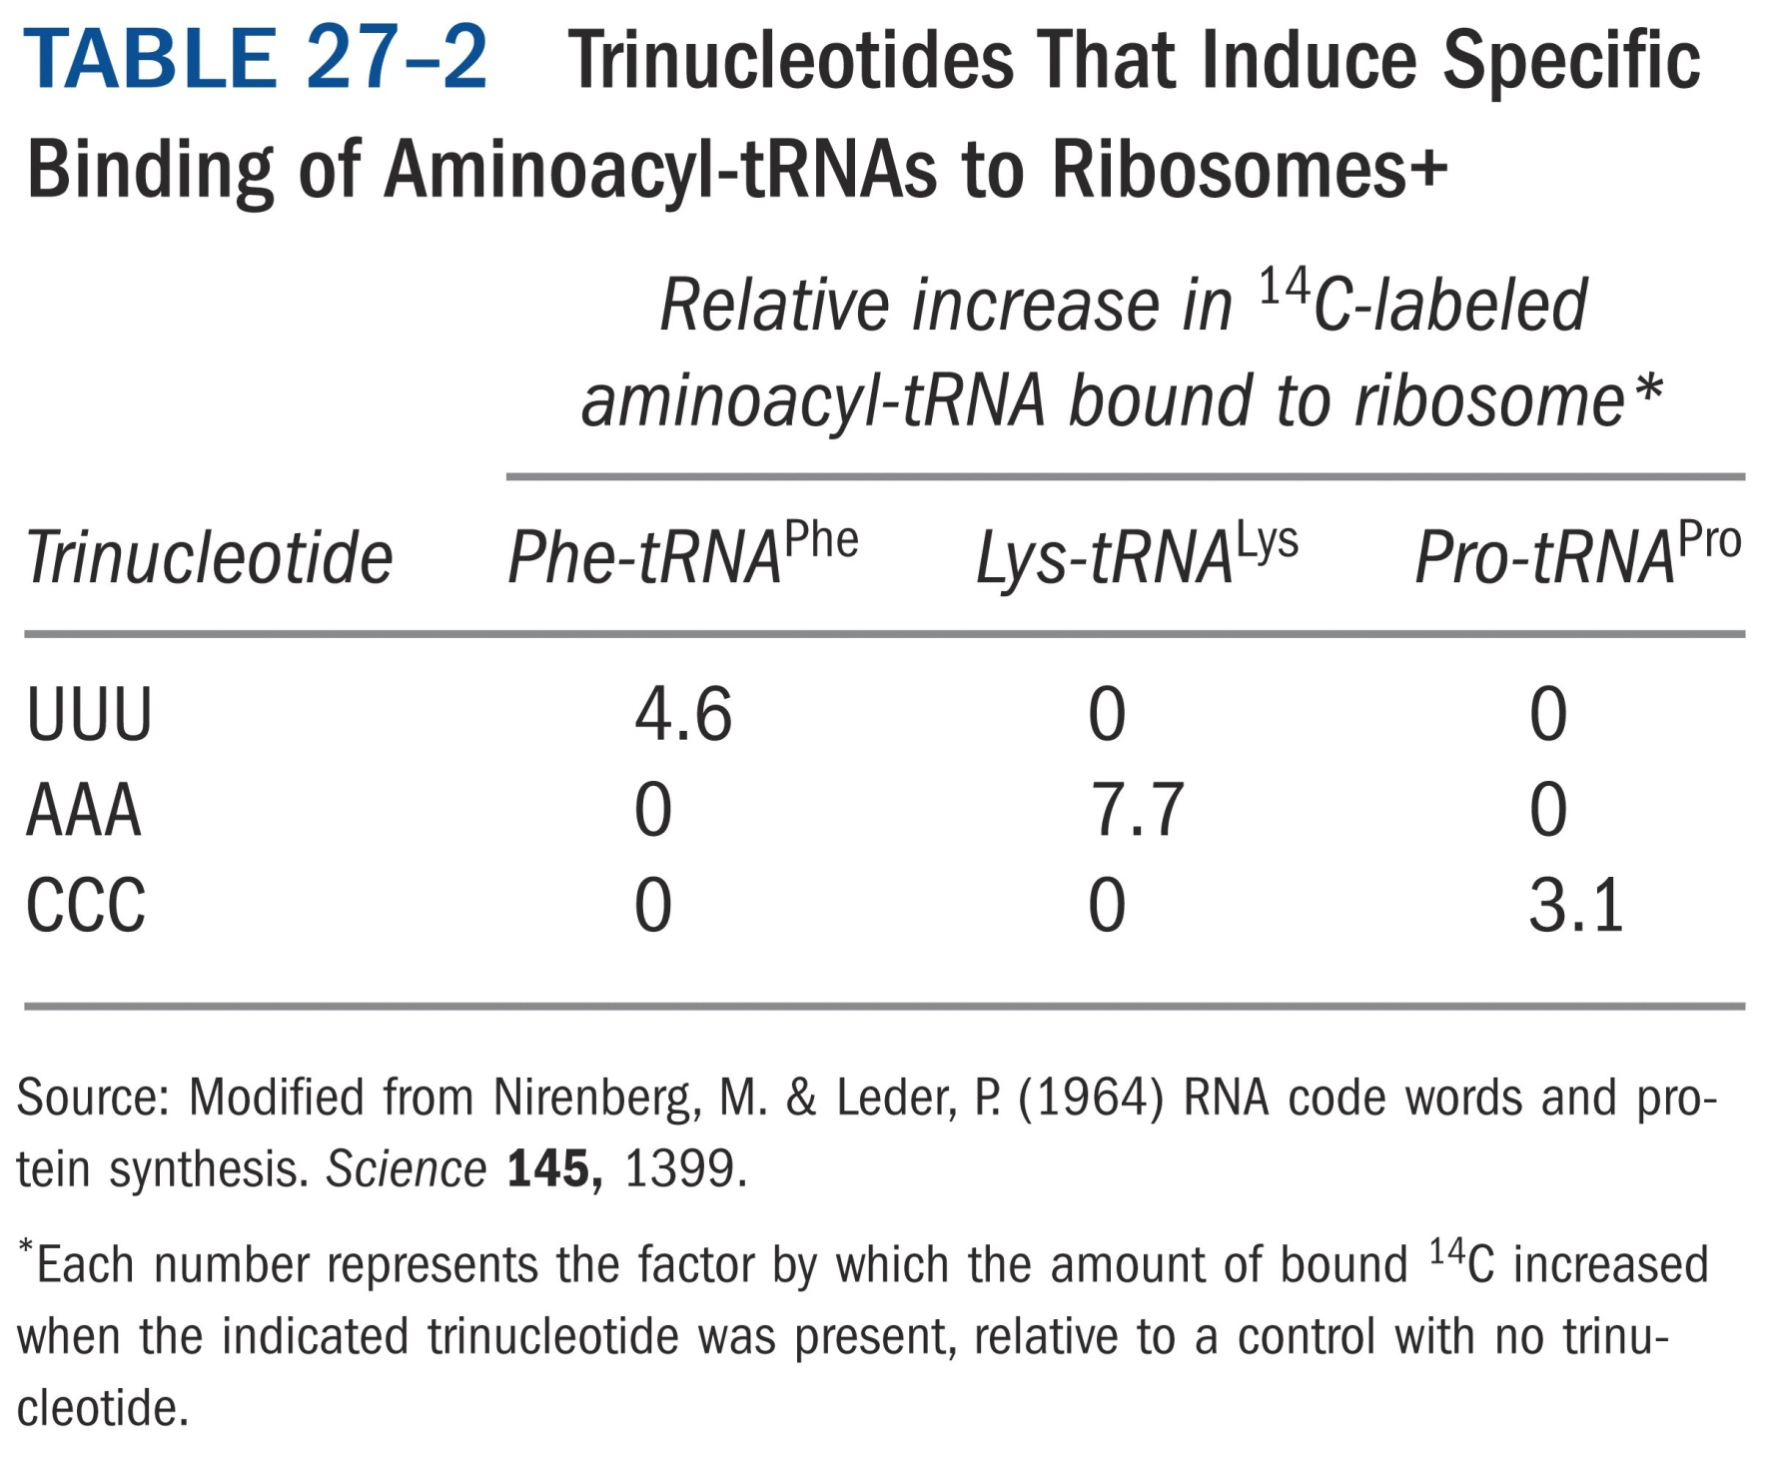

Slide 44
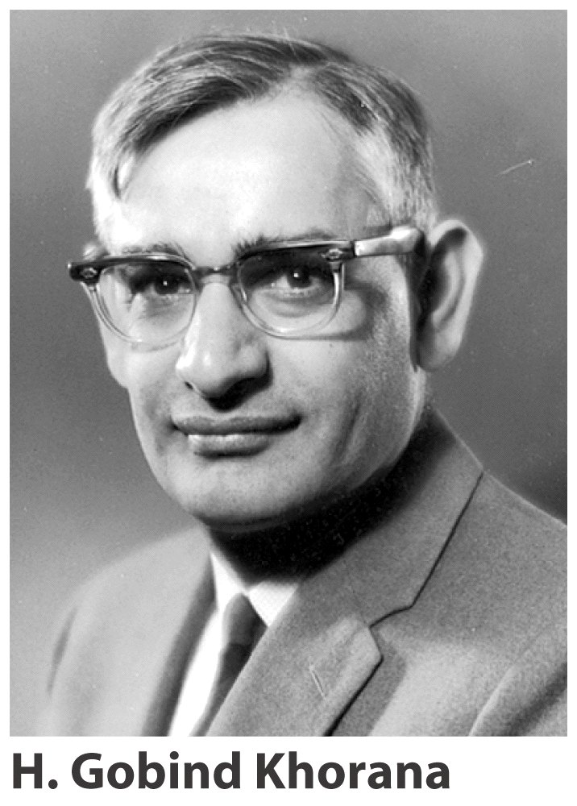
Synthesize polynucleotide with defined repeated sequences as mRNA for polypeptide synthesis
(AC)n = ACACACAC
Give 50% threonine and histidine
ACA = Thr
CAC = His

Slide 45
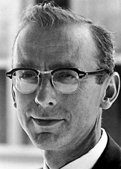
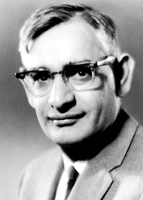
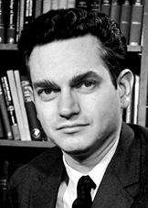
The Nobel Prize in Physiology or Medicine 1968
"for their interpretation of the genetic code and its function in protein synthesis"
Robert W. Holley | Har Gobind Khorana | Marshall W. Nirenberg
1/3 of the prize | 1/3 of the prize | 1/3 of the prize
USA | USA | USA
Cornell University Ithaca, NY, USA | University of Wisconsin Madison, WI, USA | National Institutes of Health Bethesda, MD, USA
b. 1922 d. 1993 | b. 1922 (in Raipur, India) | b. 1927 d. 2010

Slide 46
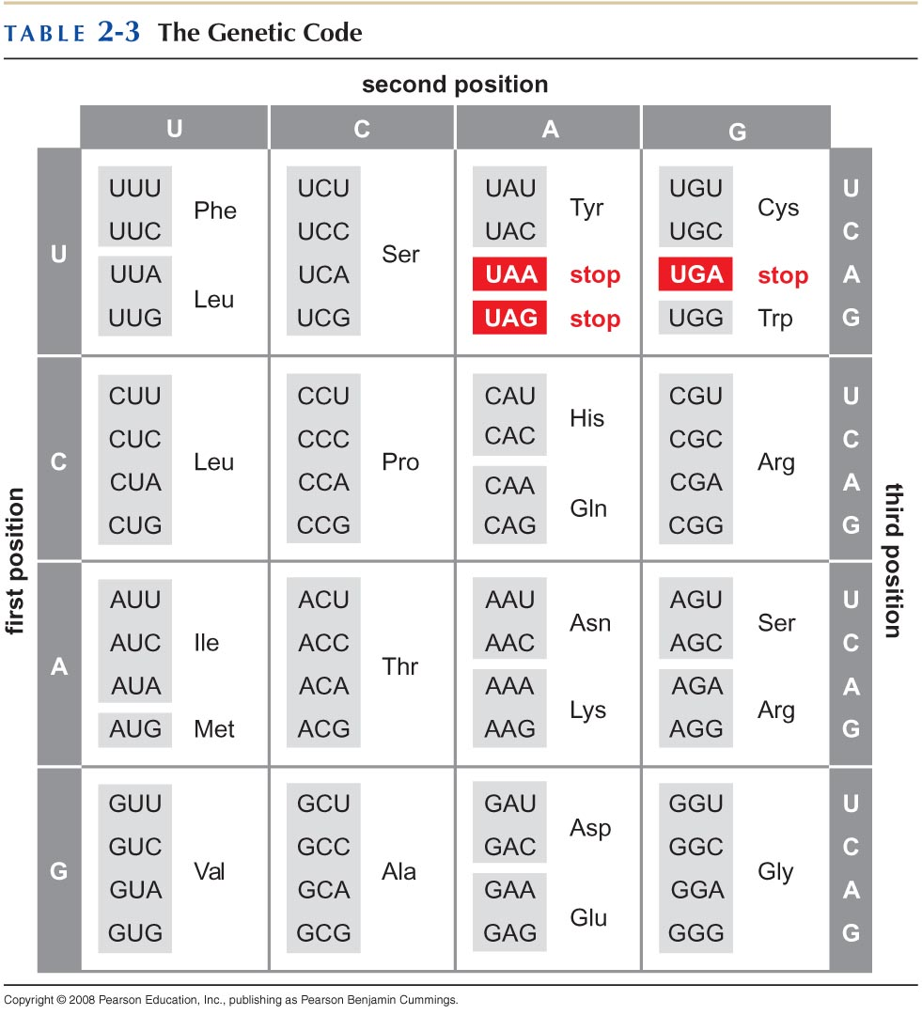

Slide 47
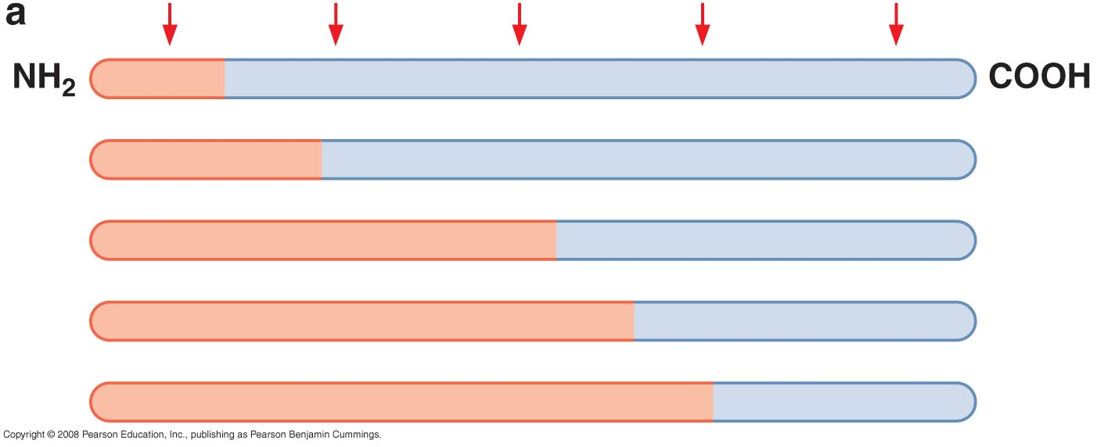
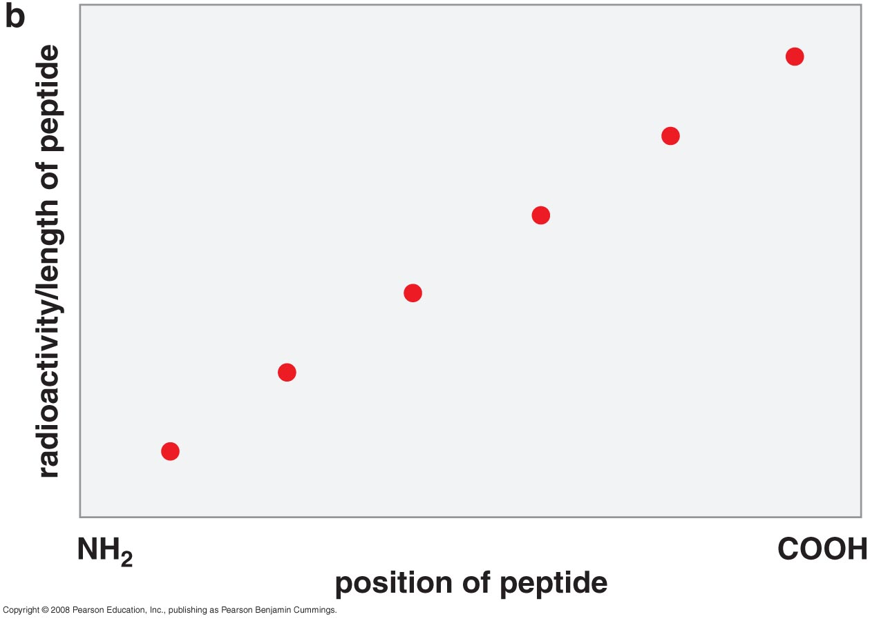
Establishing the direction of protein synthesis
Is the polypeptide chain assembled from amino- or carboxy-terminal?
Using pulse-labeling method, the protein synthesized is found to be from the N-terminal.

